Slide 1
Network : Internet Application
Jae Hyeon Kim

Slide 2
Reference
William Stalling, Data and Computer Communications 10/E, Prentice Hall

Slide 3
Email, DNS, and HTTP
Electronic mail
a facility that allows users at workstations and terminals to compose and exchange messages
Internet mail architecture (RFC 5598) consists of
a user world, in the form of Message User Agents (MUA)
the transfer world, in the form of the Message Handling Service (MHS), which is composed of Message Transfer Agents (MTA)
Domain Name Server (DNS) : RFC 1034,1035
a directory lookup service that provides a mapping between the name of a host on the Internet and its numerical address

Slide 4
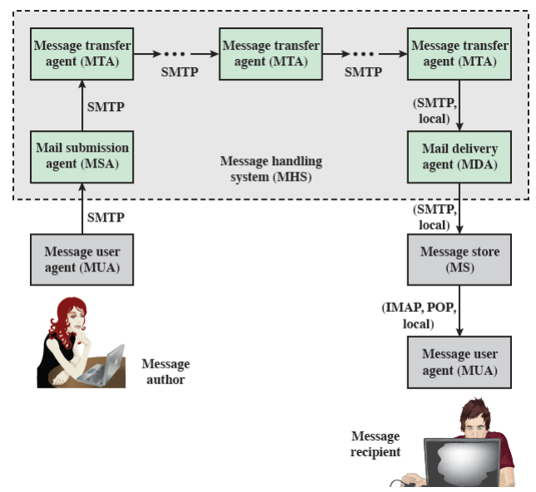
Internet Mail Architecture

Slide 5
Internet Mail Standards
Post Office Protocol (POP3) : RFC 1939
allows an e-mail client to download an e-mail from a server
Internet Mail Access Protocol (IMAP) : RFC 3501
provides stronger authentication than POP3 and provides other functions not supported by POP3, so synchronized replication
Simple Mail Transfer Protocol (SMTP) : RFC 821
protocol used for transfer of mail from a user agent to an MTA and from one MTA to another
Multipurpose Internet Mail Extensions (MIME)
supplements SMTP and allows the encapsulation of multimedia messages inside of a standard SMTP message

Slide 6
SMTP
Aims to transfer mail between hosts in the TCP/IP suite
Not concerned with the format or content of messages themselves, but with exceptions as
it standardizes the message character set as 7-bit ASCII
it adds log information to the start of the delivered message that indicates the path the message took
SMTP adapts RFC 822, which defines a format for text messages that are sent using electronic mail
an envelope : contains whatever information is needed to accomplish transmission and delivery
contents : comprise the object to be delivered to the recipient

Slide 7
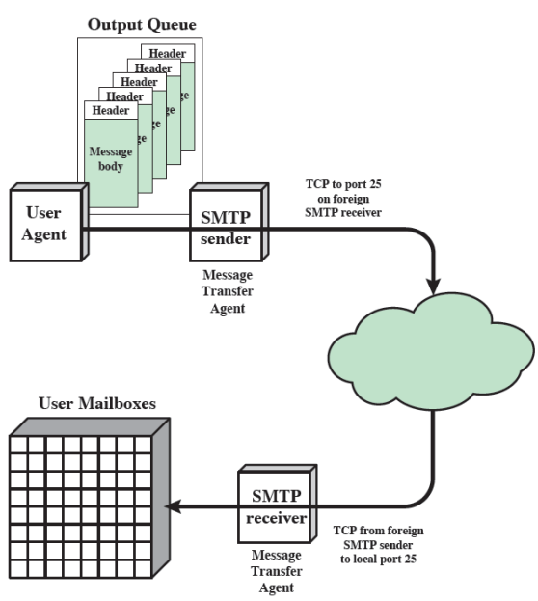
SMTP Mail Flow

Slide 8
Limitations of SMTP/822
SMTP/822
cannot transmit executable files or binary objects
cannot transmit text data that includes national language characters
may reject mail messages over a certain size
some implementations do not adhere completely to the SMTP standards defined in RFC 821
SMTP gateways that translate between ASCII and EBCDIC do not use a consistent set of mappings, resulting in translation problems

Slide 9
MIME (1)
Extension to the RFC 822 framework that
is intended to address some of the problems and limitations of the use of SMTP and RFC 822 for electronic mail
Includes the following elements:
five new message header fields are defined, which may be included in an RFC 822 header
a number of content formats are defined, thus standardizing representations that support multimedia electronic mail
transfer encodings are defined that enable the conversion of any content format into a form that is protected from the mail system

Slide 10
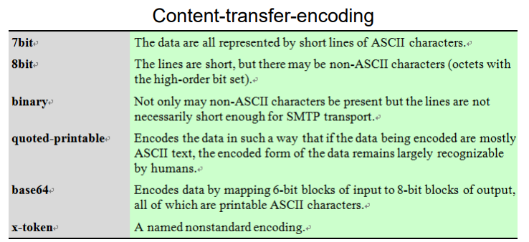
MIME (2)
MIME header fields
MIME-version
content-type
content-transfer-encoding
content-ID
content-description

Slide 11
Internet Directory Service (DNS)
A directory lookup service that provides a mapping between the name of a host and its numerical address
essential to the functioning of the Internet
defined in RFCs 1034 and 1035
Four elements comprise the DNS:
domain name space
DNS database
name servers
resolvers

Slide 12
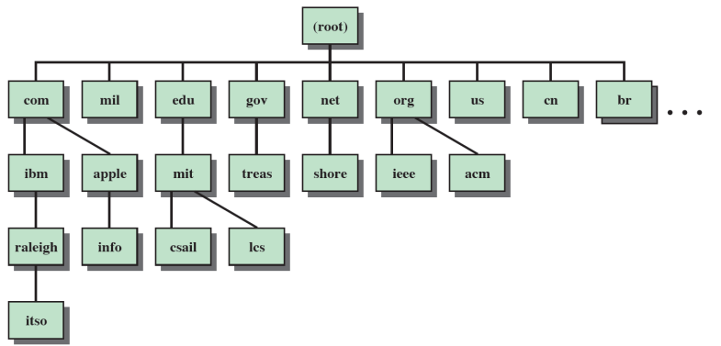
Domain
Refers to a group of hosts that are under the administrative control of a single entity
organized hierarchically, so that a given domain may consist of a number of subordinate domains
names are assigned and reflect the hierarchical organization

Slide 13
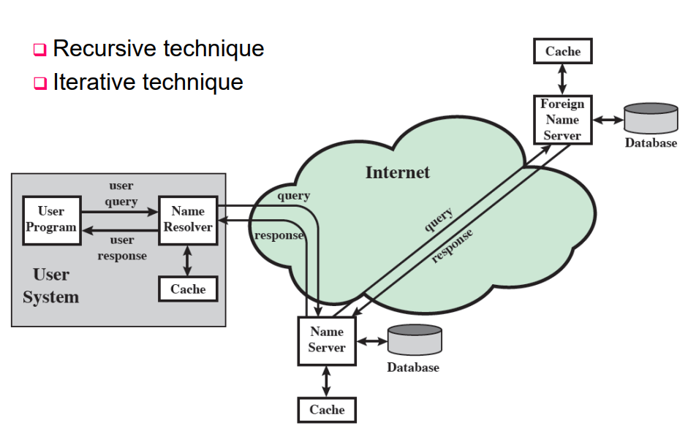
DNS Name Resolution

Slide 14
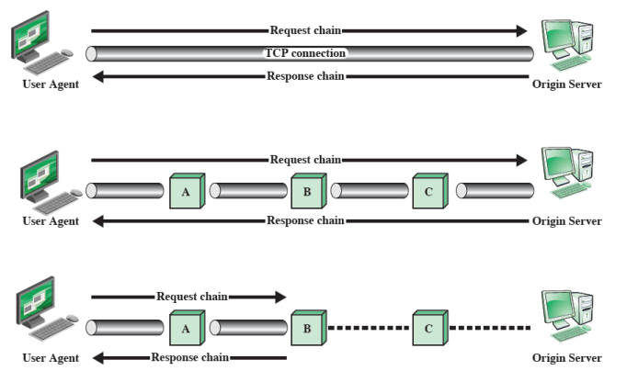
HTTP
Transaction-oriented client/server protocol
most typical use is between a Web browser and a Web server
makes use of TCP to provide reliability

Slide 15
Proxy
It is a kind of forwarding agent
receiving a request for a URL object, modifying the request, and
forwarding the request toward the server identified in the URL
Acts as a server in interacting with a client and as a client in interacting with a server
Scenarios that call for the use of a proxy:
security intermediary (such as a firewall)
different versions of HTTP (the proxy can implement both versions and perform the required mapping)

Slide 16
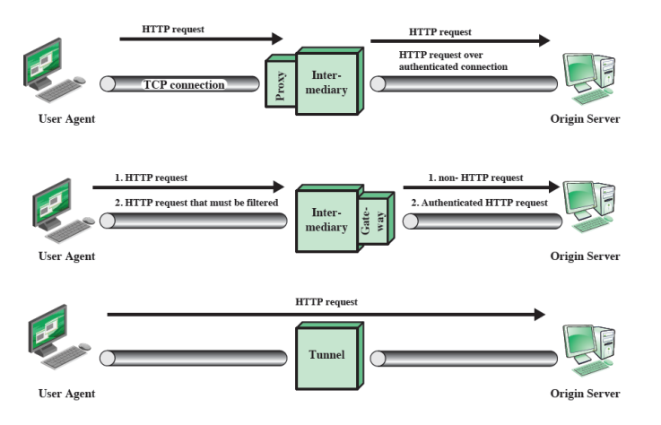
Intermediate HTTP Systems

Slide 17
Internet Multimedia Support
Requirements for real-time communication
low jitter
low latency
ability to easily integrate non-real-time and real-time services
adaptable to dynamically changing network and traffic conditions
high effective capacity utilization
good performance for large networks & large numbers of connections
modest buffer requirements within the network
low overhead in header bits per packet
low processing overhead per packet within the network and at the end system

Slide 18
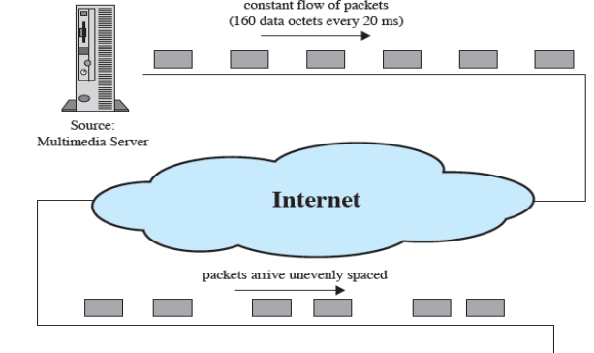
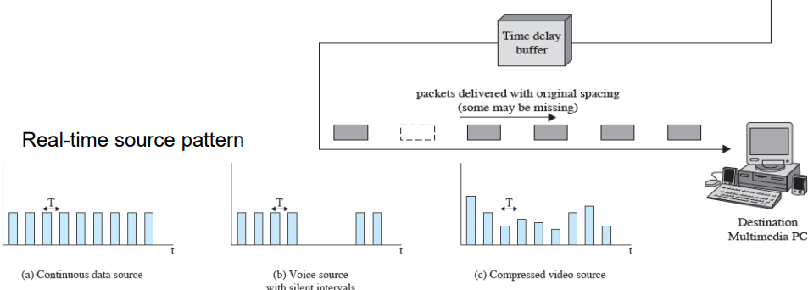
Real-time Traffic

Slide 19
Hard vs Soft Real-time Applications
Hard RT (Real Time)
have zero loss tolerance
a deterministic upper bound on jitter and high reliability takes precedence over network utilization considerations
Soft RT
can tolerate the loss of some portion of the communicated data
impose fewer requirements on the network. So permissible to focus on maximizing network utilization, even at the cost of some lost or misordered packets

Slide 20
Voice over IP (VoIP)
The transmission of speech across IP-based network
Has two main advantages over traditional telephony
cheaper to operate than an equivalent PSTN system
readily integrates with other services, such as WWW access with telephone features through a single PC
VoIP signaling
before voice can be transferred using VoIP a call must be placed
the calling user supplies the phone # of a URI which then triggers a set of protocol interactions resulting in the placement of the call
the heart of these is the Session Initiation Protocol (SIP)

Slide 21
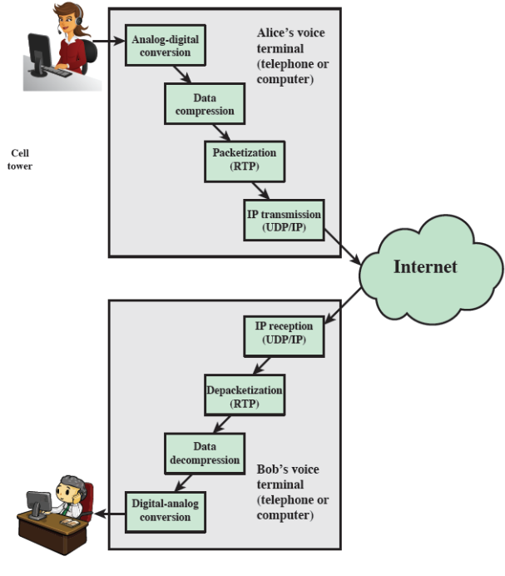
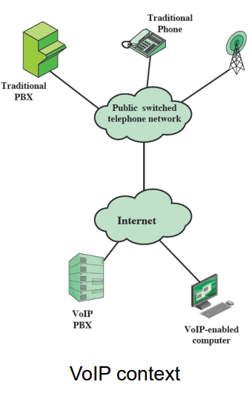
VoIP Processing

Slide 22
Real-time Transport Protocol (RTP)
Best suited to soft real-time communication
lacks the necessary mechanisms to support hard real-time traffic
RTP (RFC 3550) supports the transfer of real-time data among a number of participants in a session
a session is a logical association among two or more RTP entities that is maintained for the duration of the data transfer
it is defined by:
RTP port number
RTCP port number
Participant IP addresses

Slide 23
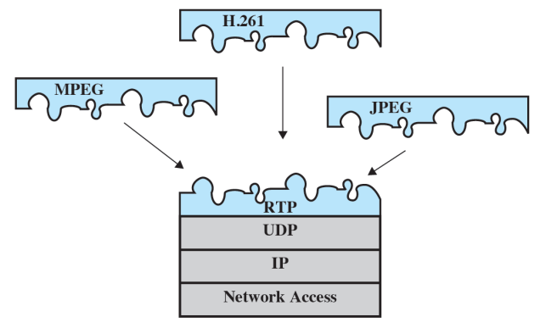
RTP Architecture
Two protocols that make up RTP are:
RTP : data transfer protocol
RTCP : control protocol
Protocol architecture

